Slide 1
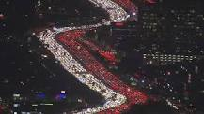
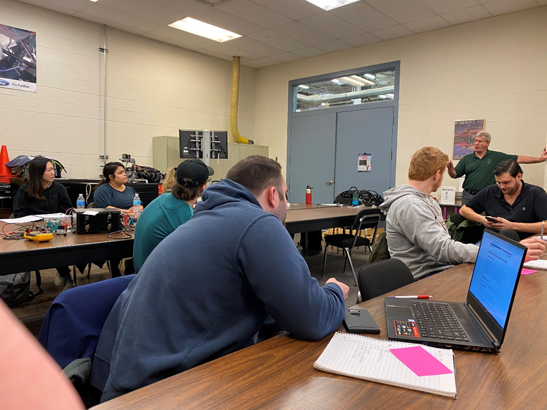
ATE 252 Exp Transportation Innovation
A multidisciplinary course providing an overview of some of the technologies for transportation in the 21st century
Course website: https://technologyrediscovery.net/data/atepilot.html
Proposed Course Outline
Week 1:Intro
Week 2: Electricity basics
Week 3: PLC
Week 4: PLC (cont)
Week 5: PLC mini project
Week 6: sensor data
Week 7: clean, assemble, and store
Week 8: share sensing data mini project
Week 9: auto sensing crash course
Week 10: auto systems
Week 11: donkey car
Week 12: donkey car simulations
Week 13:project workshop/prep time
Week 14: Showcase
Data Analysis
PLC
(Mechatronics)
Auto Tech
Transportation sub domains
road vehicles
pedestrian infrastructure
transportation
planes
boats
traffic controls
autonomous vehicles
ATE 252
Student goals:
Traffic control with PLC and collect data for future analysis
Manage multiple cars on a track
Public transportation infrastructure
Bus clustering (bunching)
Cars talk to each other
Applications of data analytics
Gathering data from non-human actions
Implications to improve road conditions
Hobby of cars
How sensors in cars communicate with each other
Java program to control a house and want s to expand
The boring company: underground transportation
Interdisciplinary course
Interest in robotics
Design transportation sub-station
Interest in learning more about PLC’s
Mapping functions
Collecting traffic data, data behind the 576 decision
PLC’s, car stuff
Roadway infrastructure specific to electric vehicles

